Slide 1

Simple Calculator
By: John Tran

Slide 2
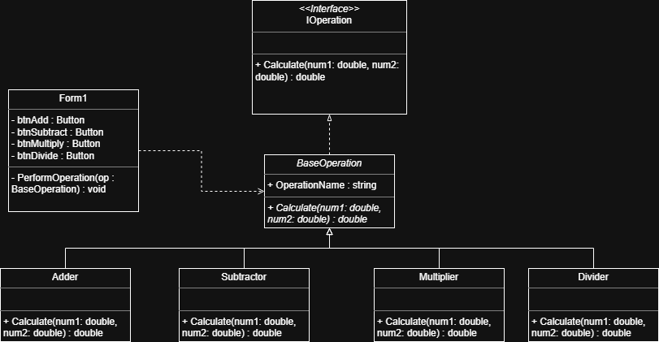
UML Diagram

Slide 3
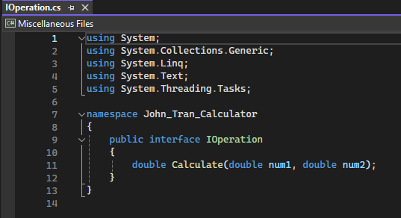
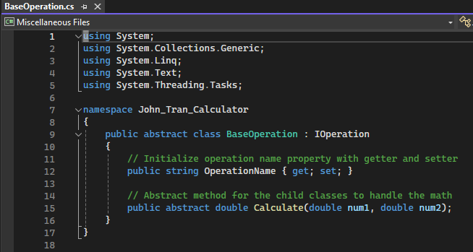
IOperation Interface
Abstract Base Class
Contains method that BaseOperation will implement
Contains abstract method that child classes will override

Slide 4
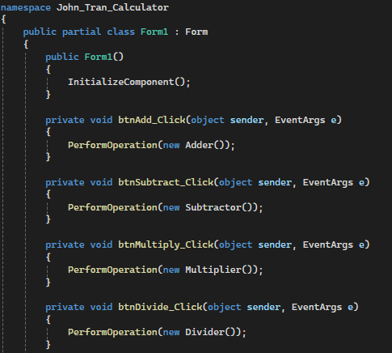
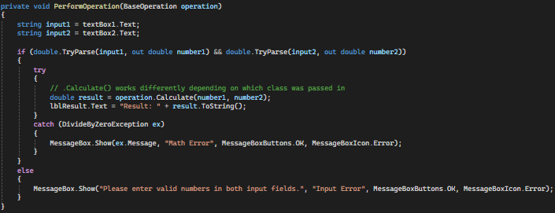
Forms Code
Perform Operation method will parse the user’s input into a double
Operation performed depends on the object which event was raised for.

Slide 5
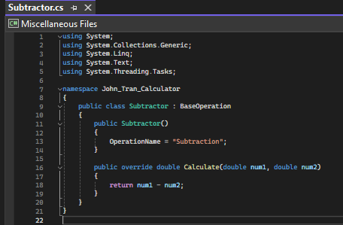
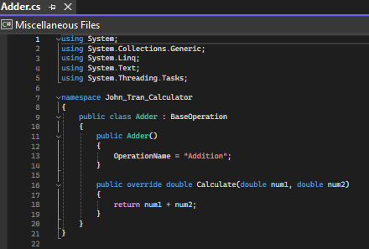
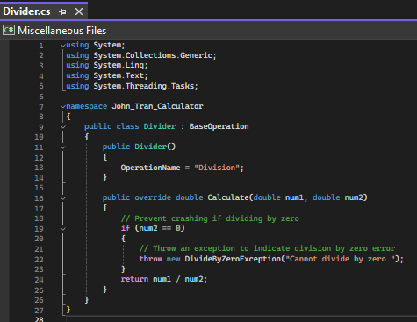
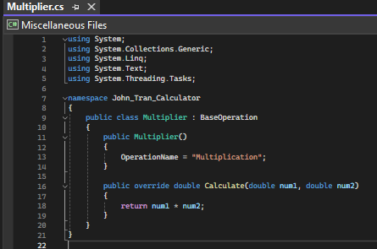
Child Class
Divider Class has exception handling which throws an exception to be caught by Form1

Slide 6
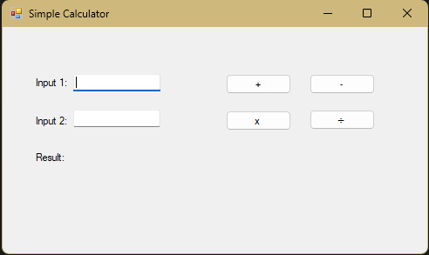
DEMO

